Slide 1
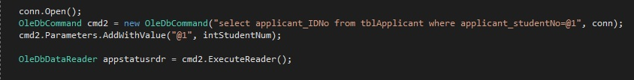


Slide 2

Moneta

Slide 3
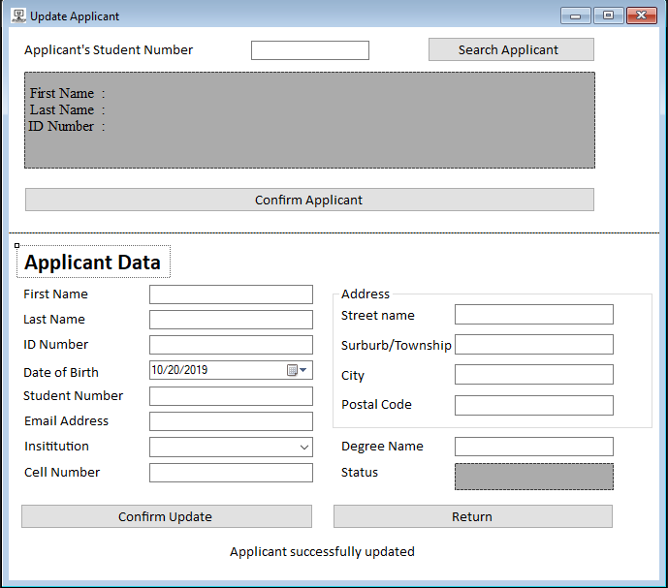
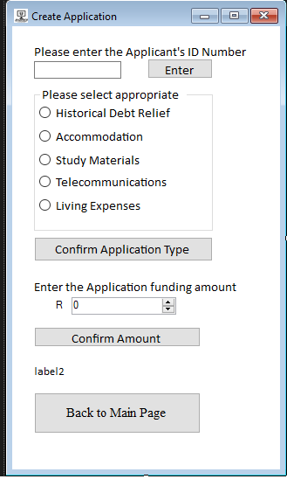
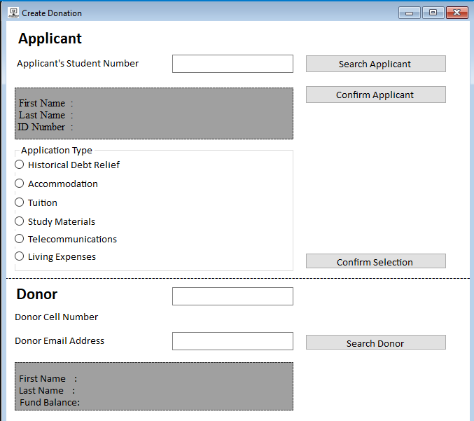
Moneta: Forms

Slide 4
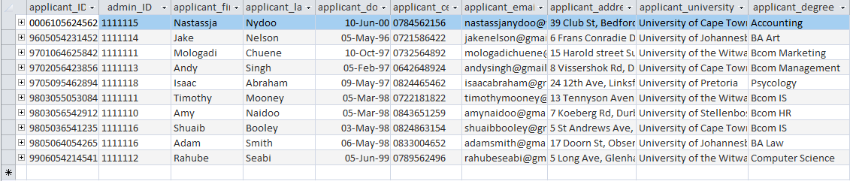
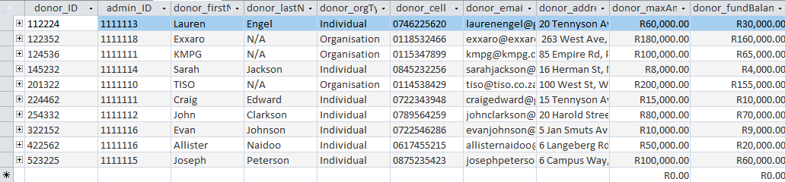
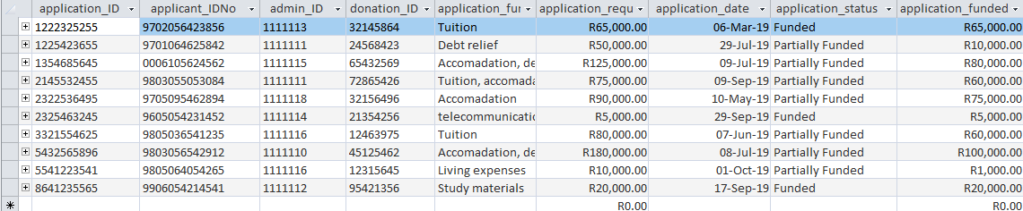
Moneta: Database
Applicant Sample
Donor Sample
Application Sample

Slide 5

Moneta: Reporting

Slide 6
A report on donors whom have not donated at least 5% of their funds within two (2) months.
“I want my money to be like a river not like a pond” ~ Lisa Sasevich
Avoid ‘losing’ money / decreasing buy power through inflation
Enquire and pursue stagnated donors to donate their money
Can increase chances of more applications being funded - the essence of #fundme
Donor’s name | Donors available balance at January 2019 (Rands) | Donors available balance at March 2019 (Rands) | Percentage of the donor’s funds that have been donated (%)
Lauren Engel | R60 000 | R30 000 | 50%
Exxaro | R180 000 | R160 200 | 11%
KMPG | R100 000 | R96 000 | 4%
Sarah Jackson | R8 000 | R8 000 | 0%
TISO | R200 000 | R45 000 | 77.5%
Craig Edward | R15 000 | R13 950 | 7%
John Clarkson | R80 000 | R64 800 | 19%
Evan Johnson | R10 000 | R6 600 | 34%
Allister Naidoo | R50 000 | R49 350 | 1.3%
Joseph Peterson | R100 000 | R98 000 | 2%

Slide 7
A report on application types that are least funded

Slide 8

Moneta: Expected Benefits

Slide 9

Moneta:

Slide 10
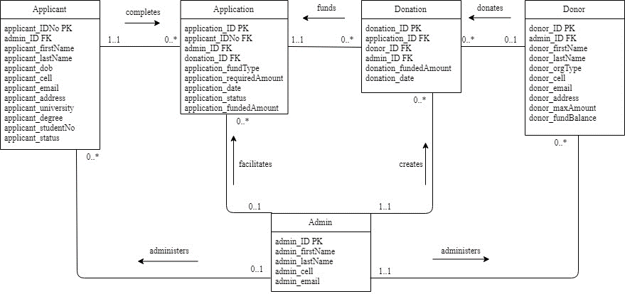

ERD:MONETA

Slide 11
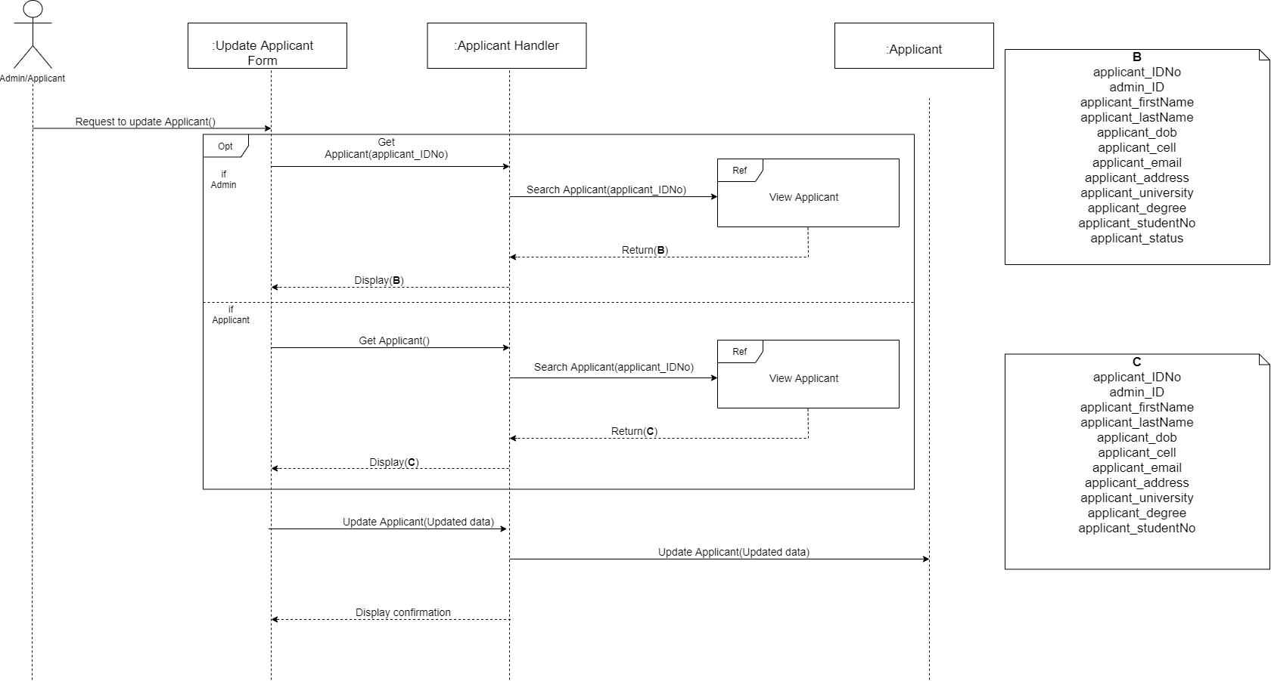
UPDATE APPLICANT

Slide 12
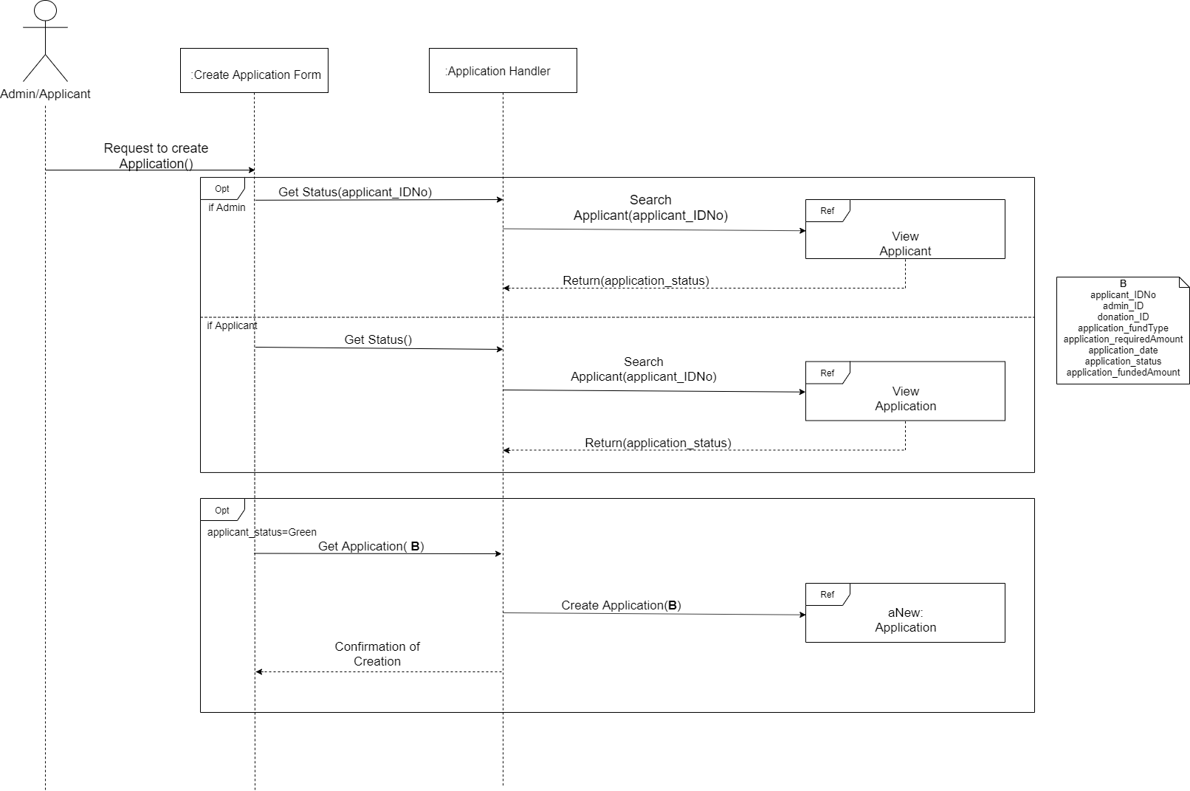
Create application

Slide 13
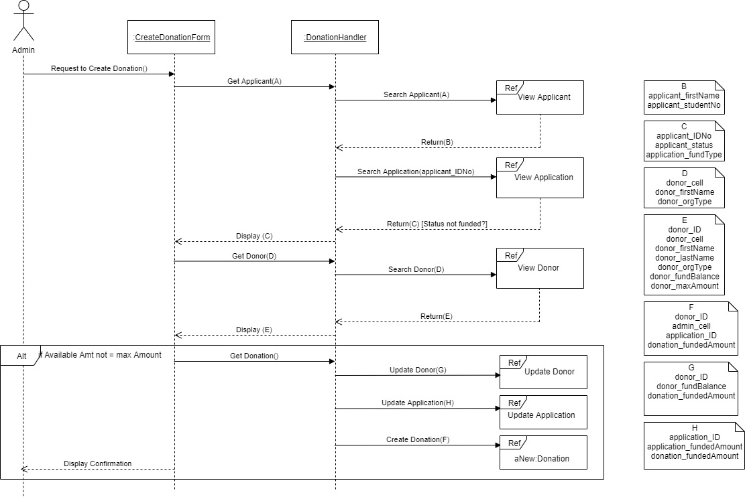
Create Donation

Slide 14

Reflection: Highlights, lowlights, Lessons

Slide 15

Where to Now?

Slide 16
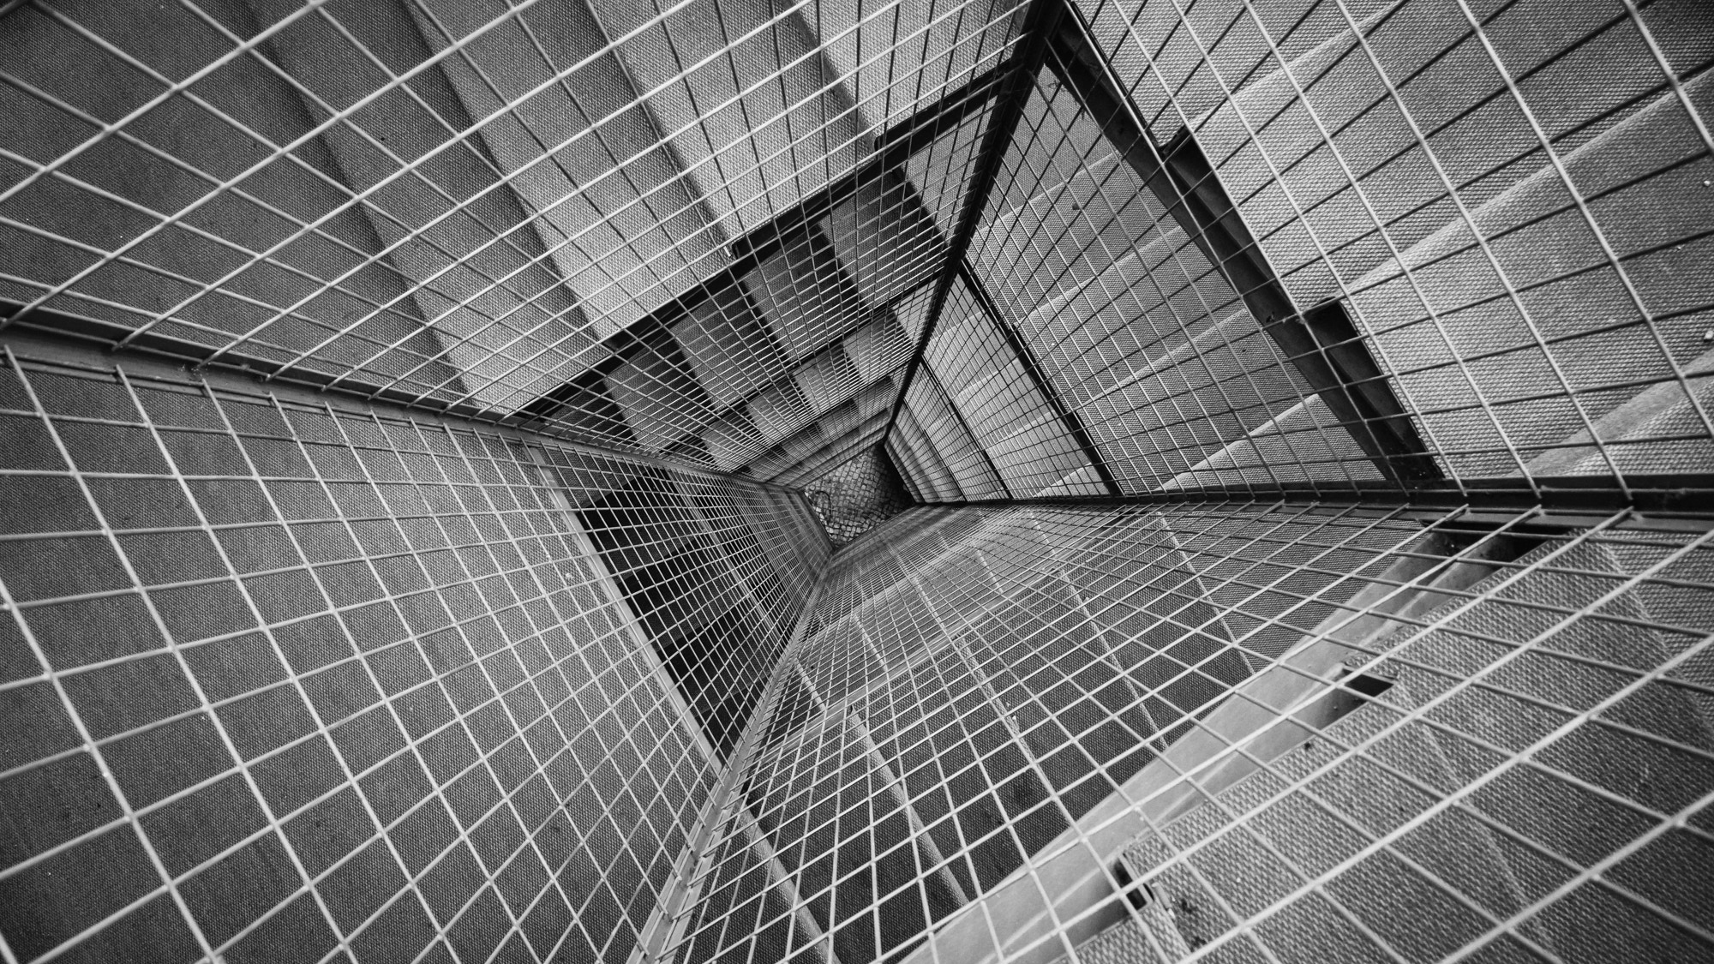



THANK YOU
WWW.SABRESSYSTEMSDESIGN.CO.ZA
MOLOGADI CHUENE (PROJECT MANAGER)
011 453 0199
mologadichuene@ssd.co.za

